Slide 1
A project on Facebook-Marketplace dataset
Using ML in python

Slide 2
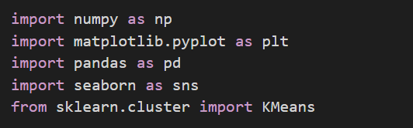
Step 1: Importing necessary libraries
The required libraries that are used are numpy , pandas, mathplotlib, seaborn and sklearn .

Slide 3
Step 2: reading the dataset from the directory
Reading the facebook_marketplace_data.csv from the directory.

Slide 4
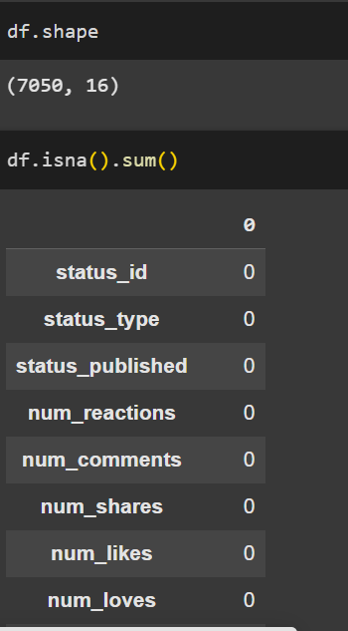
Step 3: checking for missing values
First, checking the shape i.e number of rows and columns.
There are 7050 rows and 16 columns.
Checking, the number of missing values using isna().sum() function. So, from the output we infer that there are no missing values.

Slide 5
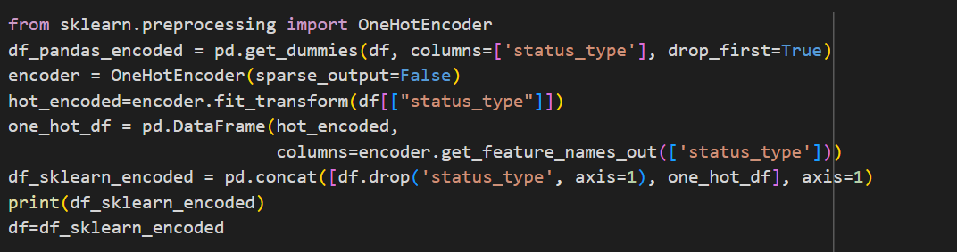
Step 4: Data preprocessing
From the dataframe, we get that there is a categorical column status_type which has four categories namely-photo, video, link,status. In order to convert the categorical variable into multiple binary column I used One-hot encoding.

Slide 6
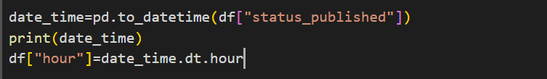
After completion of the one hot encoding, I processed the status_published column by first converting all the objects into date time values and then extracting the hours part in order to get the solution for question 1

Slide 7
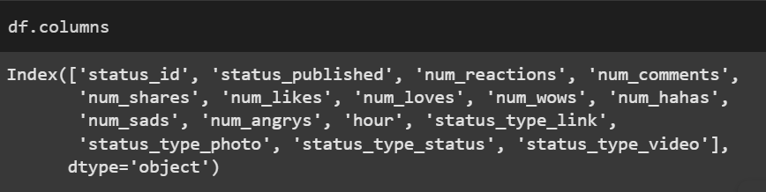
Thereafter dropping the extra columns, now the columns have dropped down to 16 and the status_type has changed to status_type_link, status_type_photo,
status_type_video, status_type_status. An extra column hour has been included which contains the hour part of status_published.

Slide 8
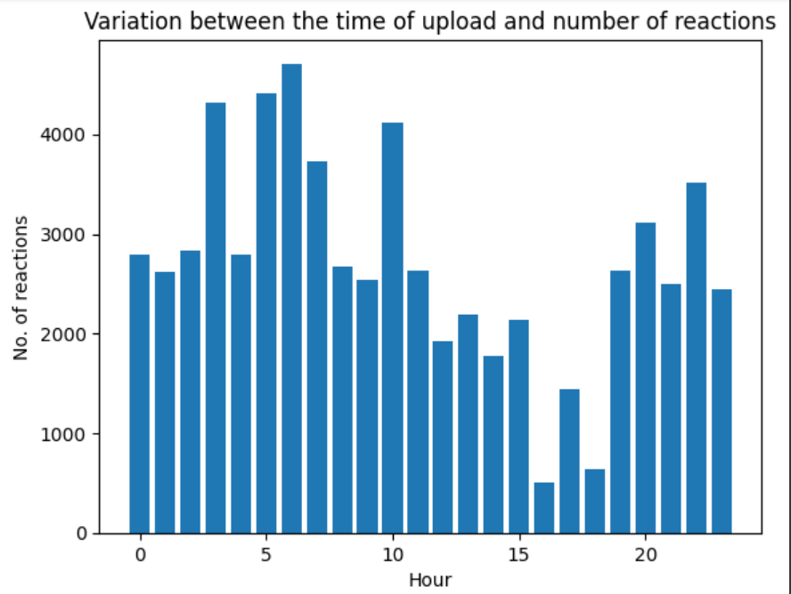
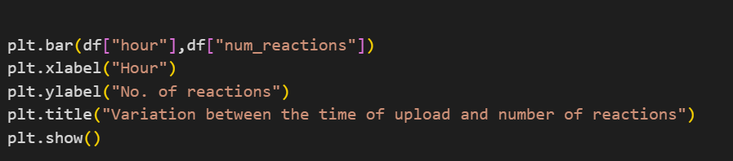
Question-1: How does the time of upload (`status_published`) affects the `num_reaction`?
In order to find the relation between the time of upload and num_reaction I have plotted a bar plot where it shows the number of reactions given at each hour. From this it can be concluded that at 6 am the number of reactions reached is the highest.

Slide 9
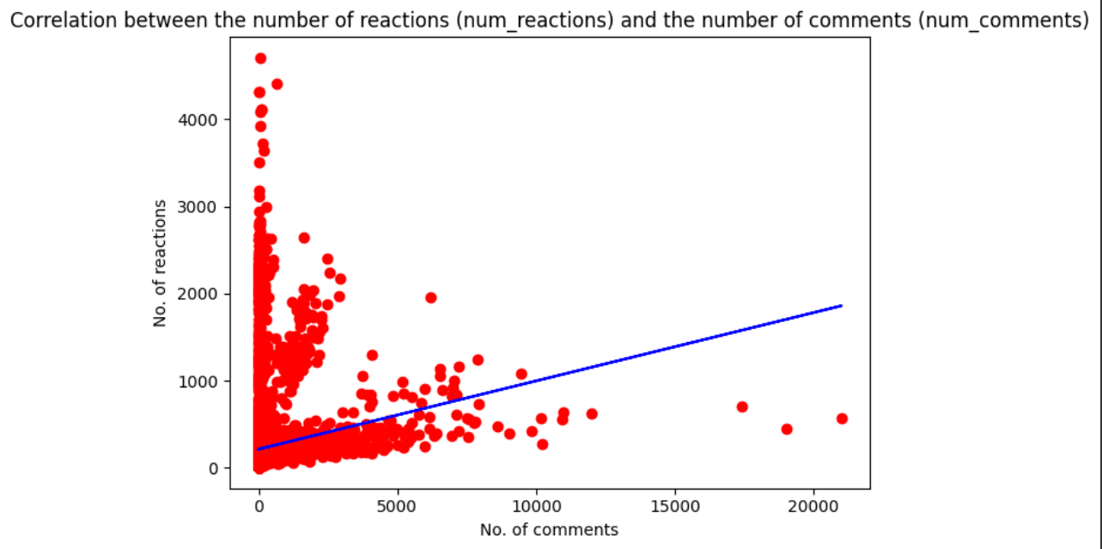
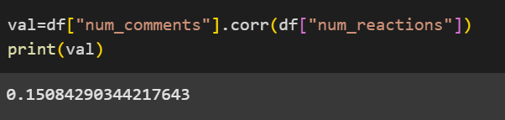
Question-2: Is there a correlation between the number of reactions (num_reactions) and other engagement metrics such as comments (num_comments) and shares (num_shares)? If so, what is the strength and direction of this correlation?
Here, the scatter plot shows the relation between the num_reactions and num_comments and the regressor line shows the direction of the correlation between the two(here it is positive correlation). Besides, I have also calculated the correlation coefficient using corr() function.

Slide 10
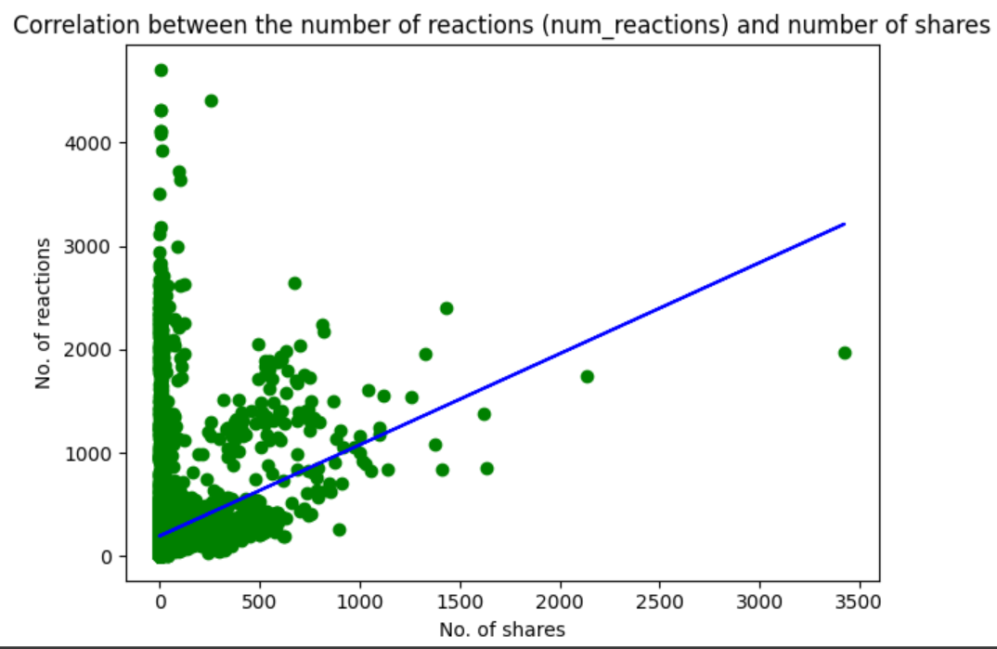
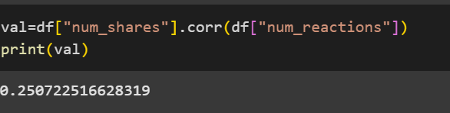
By the same procedure, I have plotted the correlation plot between num_shares and num_reactions.

Slide 11
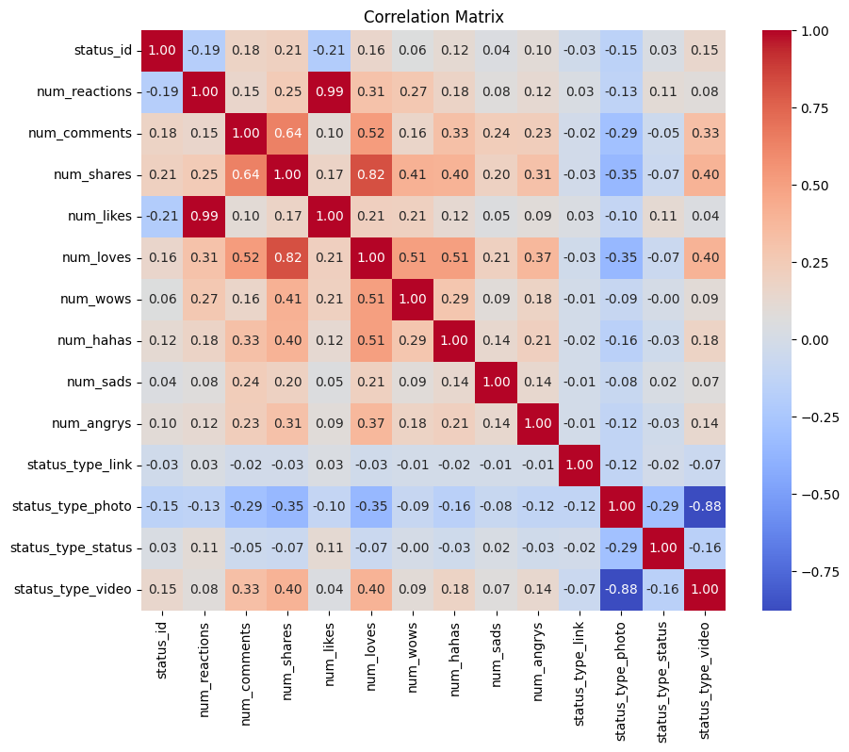
To show the correlation between all the attributes of the dataframe , I have used a heat map. The values which are near to 1 or -1 indicates that there is strong correlation between the two attributes.

Slide 12
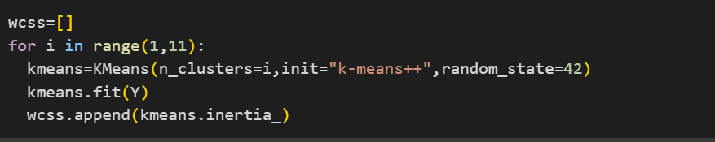
Question-3: train a K-Means clustering model on the Facebook Live Sellers dataset.
Training a k-means clustering model of facebook marketing dataset. The variable Y contains all the columns from status_type to num_angrys.

Slide 13
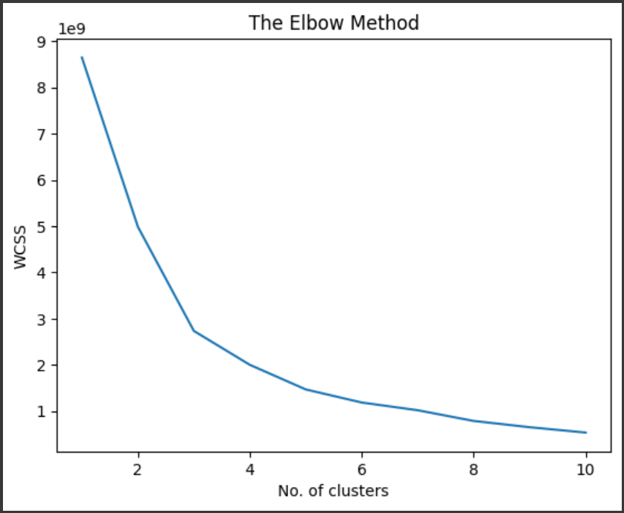
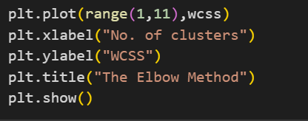
Question 4- Use the elbow method to find the optimum number of clusters.
To calculate the optimum number of clusters I have used the elbow method. From the graph we can see that the WCSS value is not significantly changing after 6. So the optimum no. of clusters is 6.

Slide 14
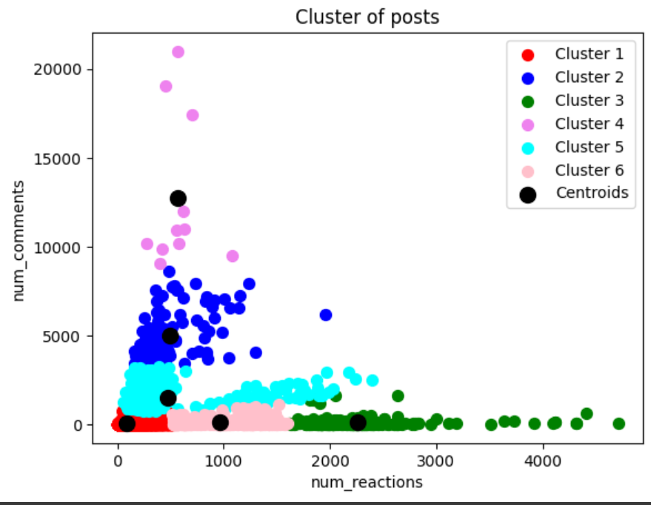
This is the plot between the num_comments and num_reactions where the 6 clusters can be distinctly seen

Slide 15

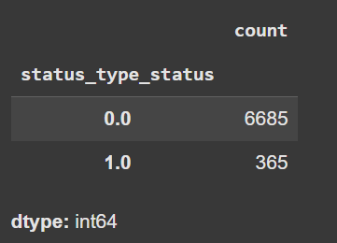
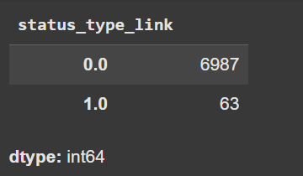
Question-5: What is the count of different types of posts in the dataset?
Using value_counts function we got the number of different types of posts. From the output ,we found that there are 6987 link posts,6685 status posts, 4288 photo posts and 4716 video posts.
The outputs of types link and status are shown

Slide 16
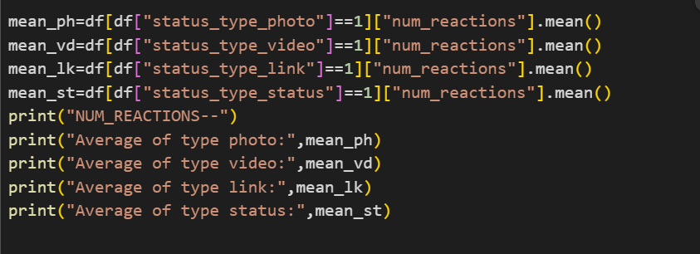
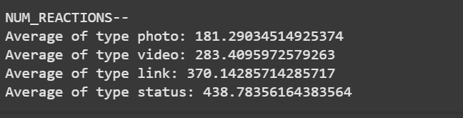
Question-6: What is the average value of num_reaction, num_comments, num_shares for each post type?
I have calculated the average of the respective posts using the following code.
The output is-
Using the process I have calculated for other three types..

Slide 17
Conclusion
So I come to the end of my project. From this wonderful project I got to learn about the Machine Learning techniques like K-means clustering, Linear Regression, and about the plotting libraries . Its my pleasure to have completed this project.

Slide 18
Thank You

